Slide 1

KCS056 APPLICATION OF
SOFT COMPUTING
UNIT-2
Prepared By- MR. Ashish Tiwari
ASSISTANT PROFESSOR
DEPARTMENT OF COMPUTER SCIENCE ENGINEERING
UNITED COLLEGE OF ENGG. & RESEARCH, PRAYAGRAJ

Slide 2
Unit -2
Neural Networks-II (Back Propagation Network
Back-Propagation Network, topics : Background, what is back-prop network ? learning AND function, simple learning machines – Error measure, perceptron model Perceptron learning rule, Hidden Layer, Back-Propagation Learning : learning by example, single layer artificial neural network multi-layer feed- forward back-propagation network, computation in input, hidden and output layers, error calculation. Back-propagation algorithm for training network - basic loop structure, step-by-step procedure, numerical example. factors affecting back propagation training, applications.

Slide 3
LECTURE - 6

Slide 4
Outlines of Today's Lecture
Introduction
Back propagation algorithm
Numerical Questions and Answers

Slide 5
Back propagation Algorithm
The back propagation learning algorithm can be divided into two phases:
Phase 1: Propagation
Forward propagation of a training pattern's input through the neural network in order to generate the propagation's output activations.
Backward propagation of the propagation's output activations through the neural network using the training pattern target in order to generate the deltas (the difference between the input and output values) of all output and hidden neurons.
Phase 2: Weight update
Multiply its output delta and input activation to get the gradient of the weight.
Subtract a ratio (percentage) of the gradient from the weight.

Slide 6
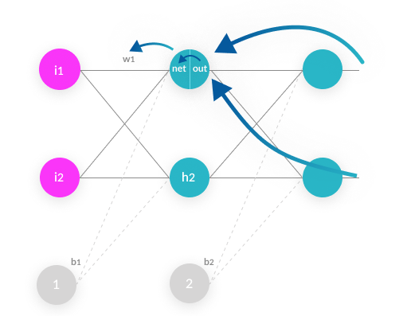

Slide 7
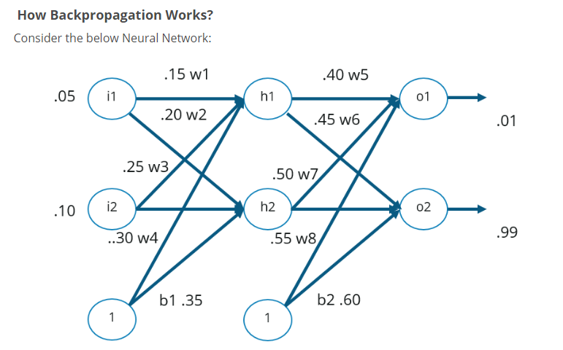

Slide 8
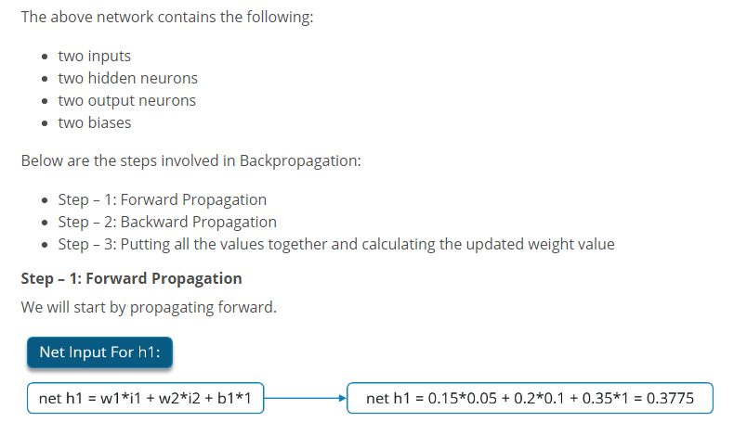

Slide 9
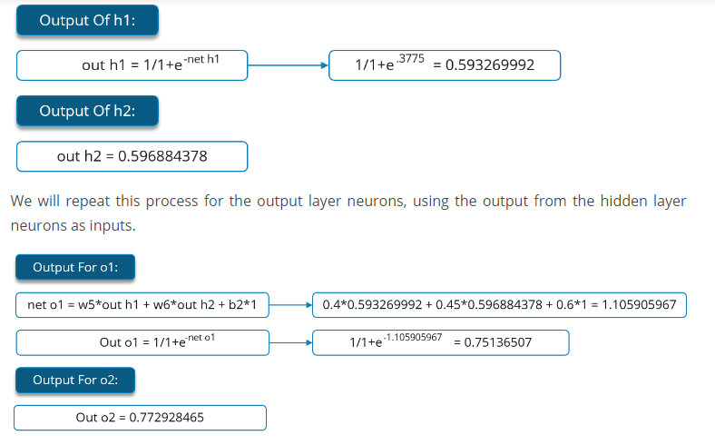

Slide 10
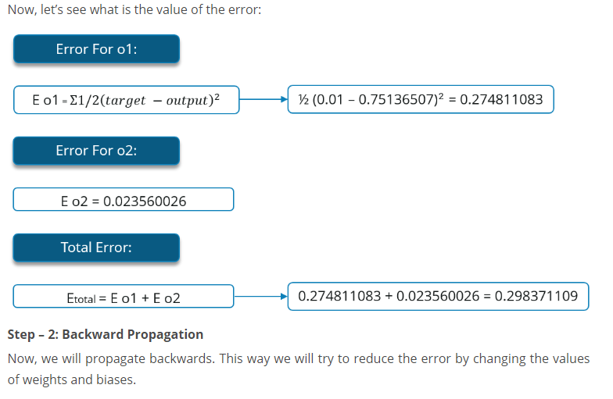

Slide 11
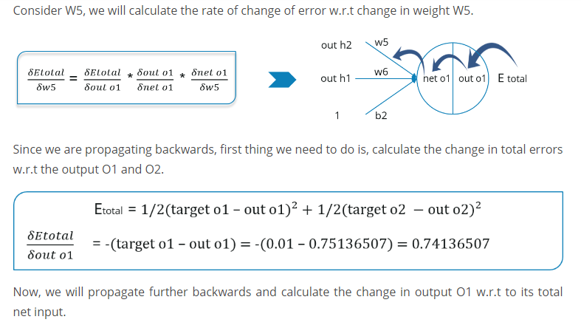

Slide 12
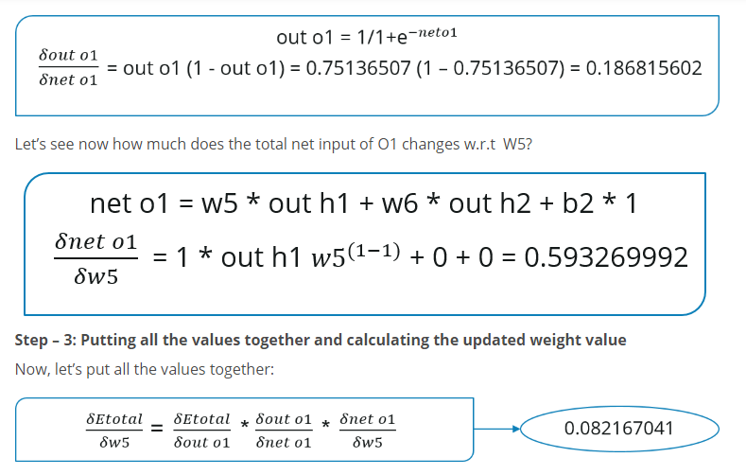

Slide 13
